Slide 1
MEDICAL SHOP BILLING SYSTEM
DBMS PROJECT REPORT
Submitted By
Divyansh Gupta (019)
Sanskar Jaiswal(044)
Submitted To
Dr. Deepak Kumar
HOD (CSE Dept.)

Slide 2
CONTENTS
INTRODUCTION
SOFTWARE REQUIREMENTS
FEATURES
HOW TO RUN
TABLES, SQL QUERIES AND DATABASE
ENTITY RELATIONSHIP DIAGRAM

Slide 3
INTRODUCTION
This Medical Shop Billing System is created using python and MySQL.
This Billing System can be used by pharmacy to manage their database easily, effectively and smoothly.
ADMIN can keep track on sales, add new medicines, update price, delete or add user from database.
User can create, view and delete bill from database.

Slide 4
SOFTWARE REQUIREMENTS
Language used : Python
Technologies : HTML, CSS, Bootstrap, Flask
Database : MySQL Database
Server : Local
Host IDE : VS Code

Slide 5
HOW TO RUN
Open The Xampp Server
Start MYSQL
Run Created.py Script From Dbms Project Folder(once for the system)
Run Main.py Script From Dbms Project Folder

Slide 6
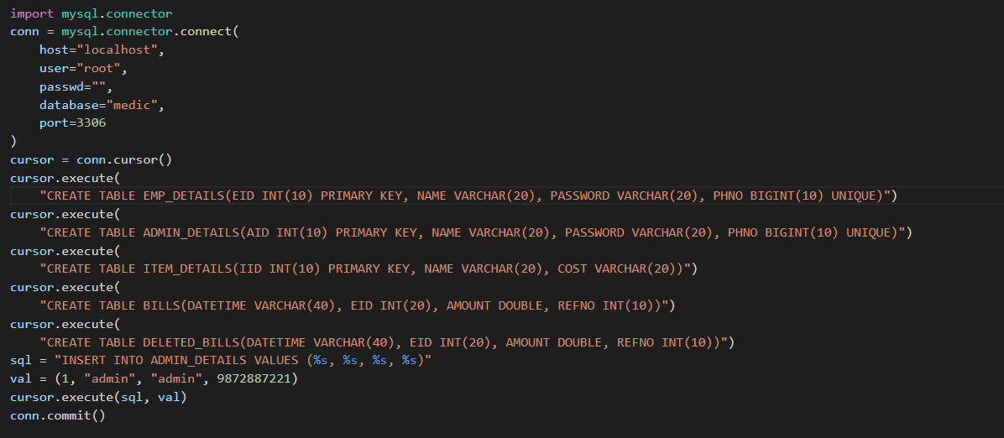
SQL DATABASE QUERIES

Slide 7

LOGIN PAGE
FEATURES
Admin Login
User Login
Exit Button

Slide 8
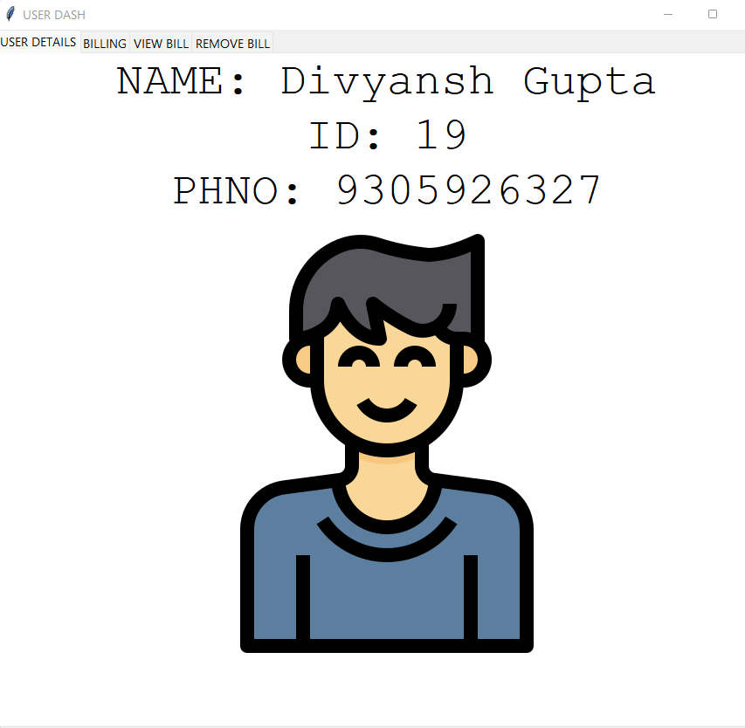
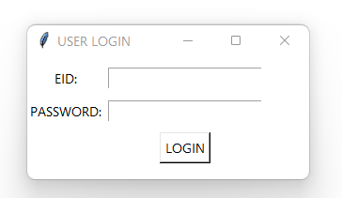
USER(EMPLOYEE) LOGIN PAGE
LOGIN

Slide 9
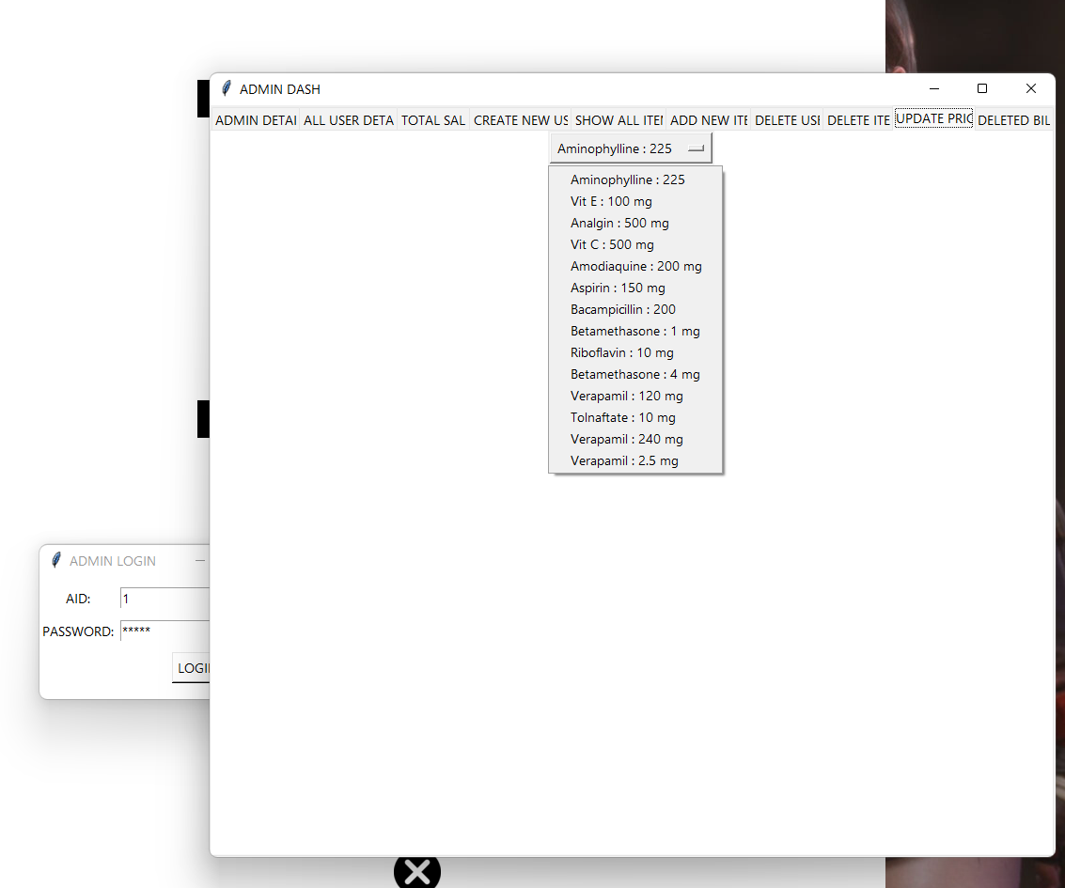
ADMIN LOGIN PAGE
FEATURES
Admin Details
All User Data
Total Sale
Create New User
Show All Item
Add New Item
Delete User
Delete Item
Update Price
Delete Bill

Slide 10
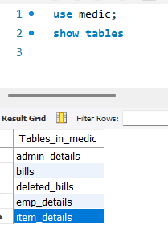
ALL TABLES IN MEDIC SQL STATEMENT AND TABLE
Tables_in_medic
Admin_details
Bills
Deleted_bills
Emp_details
Item_details

Slide 11
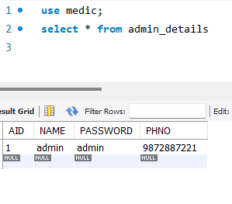
ADMIN DETAILS SQL STATEMENT, TABLE AND DATABASE
TABLE CONTENTS
AID (PK)
NAME
PASSWORD
PHNO

Slide 12
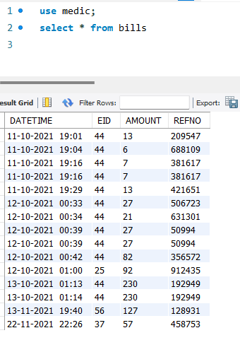
BILLS SQL STATEMENT, TABLE AND DATABASE
SQL STATEMENT
* use medic;
* Select * from bills
TABLE CONTENTS
DATE
TIME
EID
AMOUNT
REFNO

Slide 13
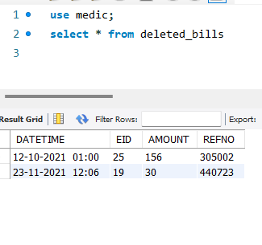
DELETED BIILS SQL STATEMENT, TABLE AND DATABASE
TABLE CONTENTS
DATE
TIME
EID
AMOUNT
REFNO

Slide 14
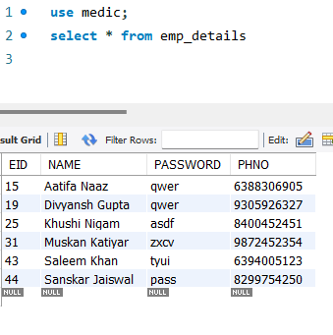
EMP DETAILS SQL STATEMENT, TABLE AND DATABASE
TABLE CONTENTS
EID (PK)
NAME
PASSWORD
PHNO

Slide 15
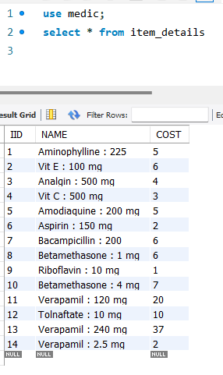
ITEM DETAILS SQL STATEMENT, TABLE AND DATABASE
TABLE CONTENTS
IID (PK)
NAME
COST

Slide 16
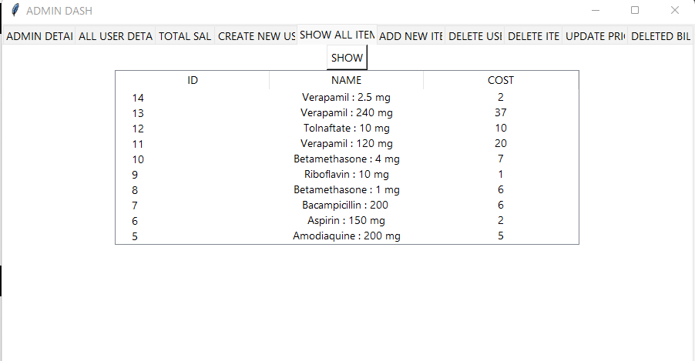
TABLE OF ALL ITEMS ADDED SQL STATEMENT, TABLE AND DATABASE
TABLES CONTENTS
ID (PK)
NAME
COST

Slide 17
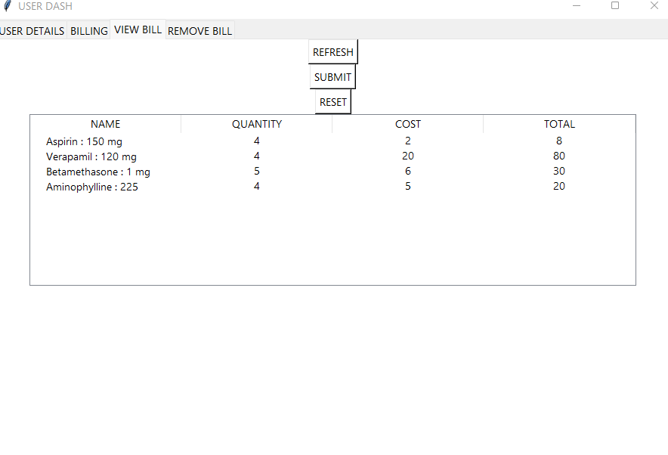
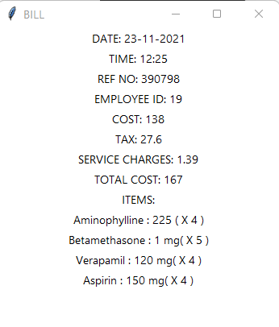
TABLES AND OUTPUT OF BILLING
SUBMIT

Slide 18
E-R DIAGRAM
NEXT PAGE

Slide 19
Emp_details
EID
NAME
PHNO
PASSWORD
Bills
EID
REFNO
DATETIME
AMOUNT
BILLING
DELETES
Deleted_bills
EID
REFNO
DATETIME
AMOUNT
EMPLOEEY
Item_details
Cost
Name
IID
admin_
details
AID
NAME
PASSWORD
PHNO
ITEMS

